Slide 1



Separations for Estimating Large Frequency Moments on Data Streams
David P. Woodruff
Samson Zhou

Slide 2
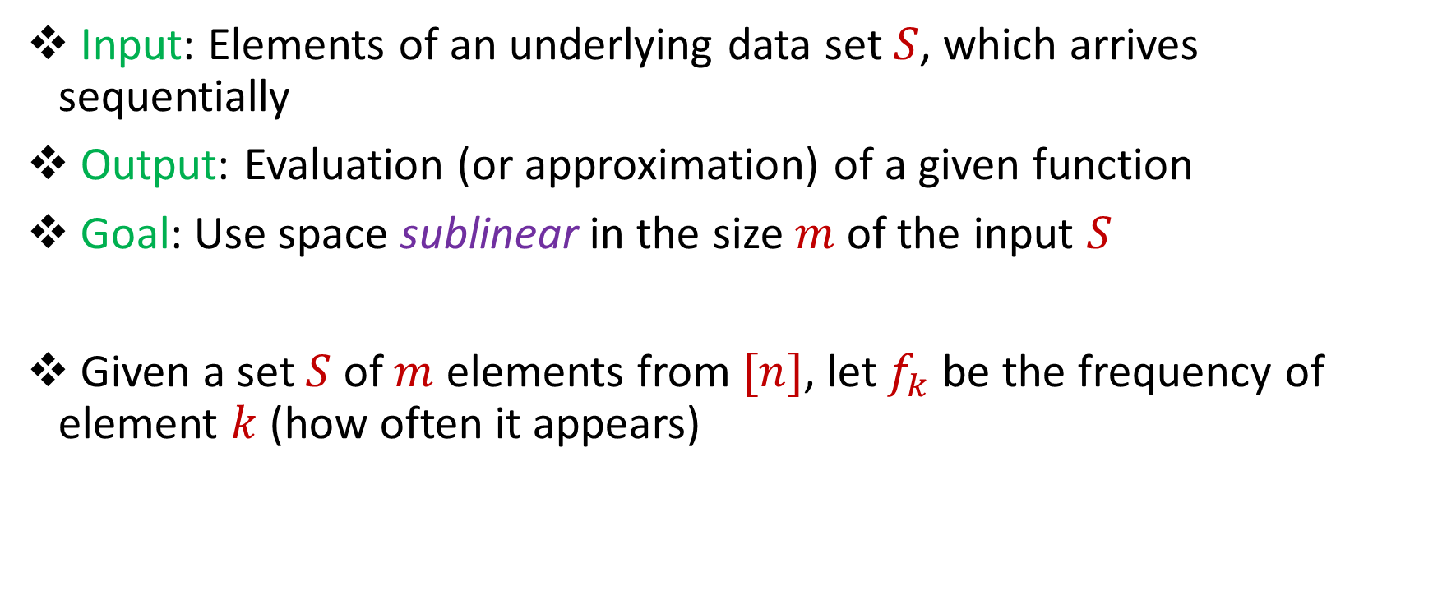
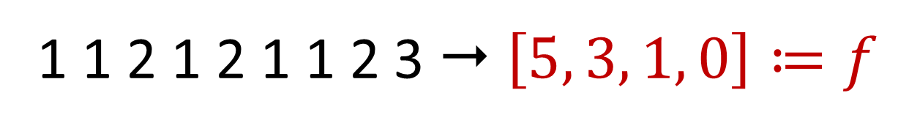
Streaming Model
Input: Elements of an underlying data set $S$, which arrives sequentially
Output: Evaluation (or approximation) of a given function
Goal: Use space sublinear in the size $m$of the input $S$
Given a set $S$ of $m$ elements from $[n]$, let $f_{k}$ be the frequency of element $k$ (how often it appears)
1 1 2 1 2 1 1 2 3  $\left[5, 3, 1, 0\right]≔f$
Notes:
Let’s start by breaking down each of the terms in the title. To understand the sliding window model, we first have to understand the streaming model of computation, in which elements of an underlying data set S, arrive sequentially and the goal is to evaluate or approximate some given function on this dataset, using space sublinear in S. In the sliding window model, only the W most recent updates form the underlying data set

Slide 3
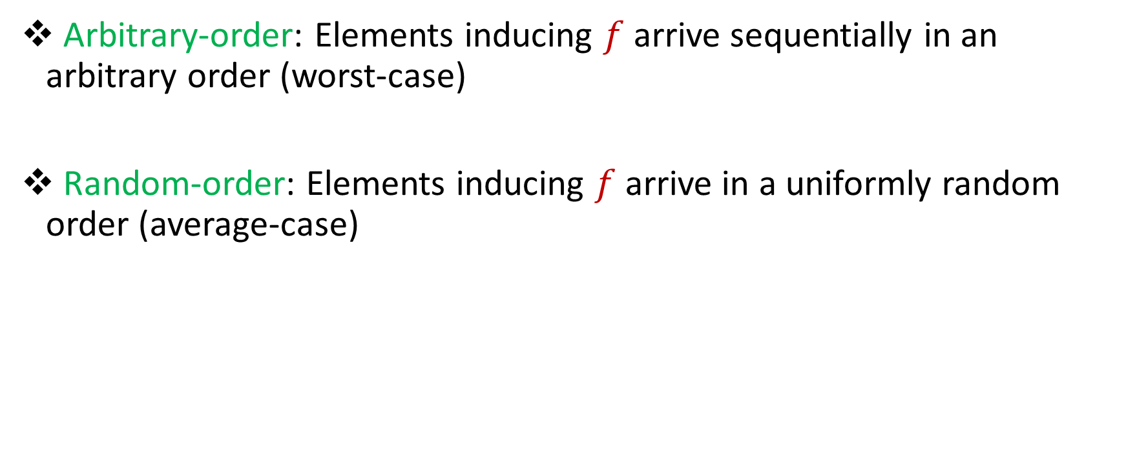
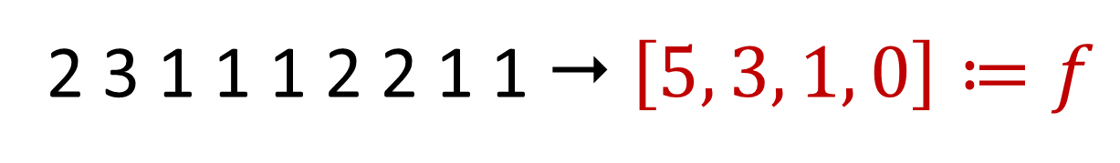

Arbitrary-Order vs Random-Order Streams
Arbitrary-order: Elements inducing $f$arrive sequentially in an arbitrary order (worst-case)
Random-order: Elements inducing $f$arrive in a uniformly random order (average-case)
1 1 2 1 2 1 1 2 3  $\left[5, 3, 1, 0\right]≔f$
2 3 1 1 1 2 2 1 1  $\left[5, 3, 1, 0\right]≔f$
Notes:
Let’s start by breaking down each of the terms in the title. To understand the sliding window model, we first have to understand the streaming model of computation, in which elements of an underlying data set S, arrive sequentially and the goal is to evaluate or approximate some given function on this dataset, using space sublinear in S. In the sliding window model, only the W most recent updates form the underlying data set

Slide 4
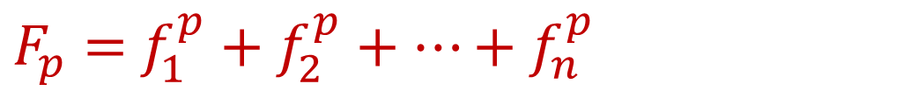
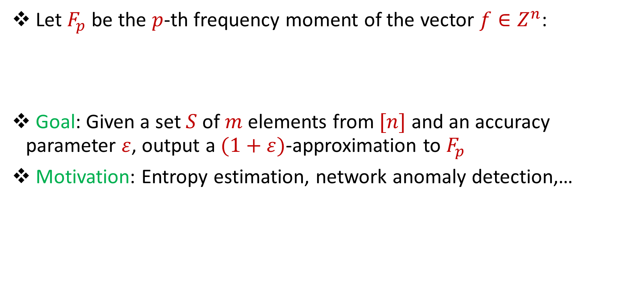
Frequency Moments
Let $F_{p}$ be the $p$-th frequency moment of the vector $f∈Z^{n}$:
Goal: Given a set $S$ of $m$ elements from $[n]$ and an accuracy parameter $ε$, output a $(1+ε)$-approximation to $F_{p}$
Motivation: Entropy estimation, network anomaly detection,…
$F_{p}=$ $f_{1}^{p}+f_{2}^{p}+…+f_{n}^{p}$

Slide 5

Constant-Factor Approximation
Space $O\left(\log{n}\right)$ algorithm for $F_{p}$ with $p∈\left(0, 2\right]$ [BlasiokDingNelson17, BravermanViolaWoodruffYang18]
Space $\tilde{Ω}\left(n^{1−2/p}\right)$ necessary for $F_{p}$ with $p>2$ [Ganguly12] on arbitrary-order streams, $Ω\left(n^{1−2.5/p}\right)$ for random-order streams [ChakrabartiCormodeMcGregor16]

Slide 6
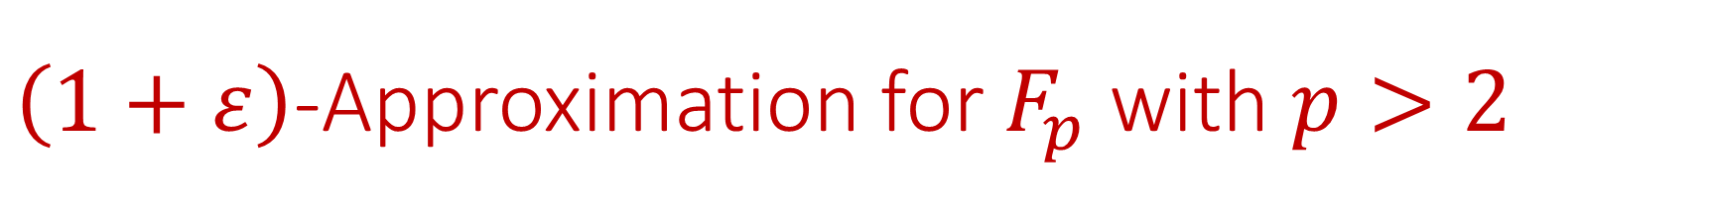
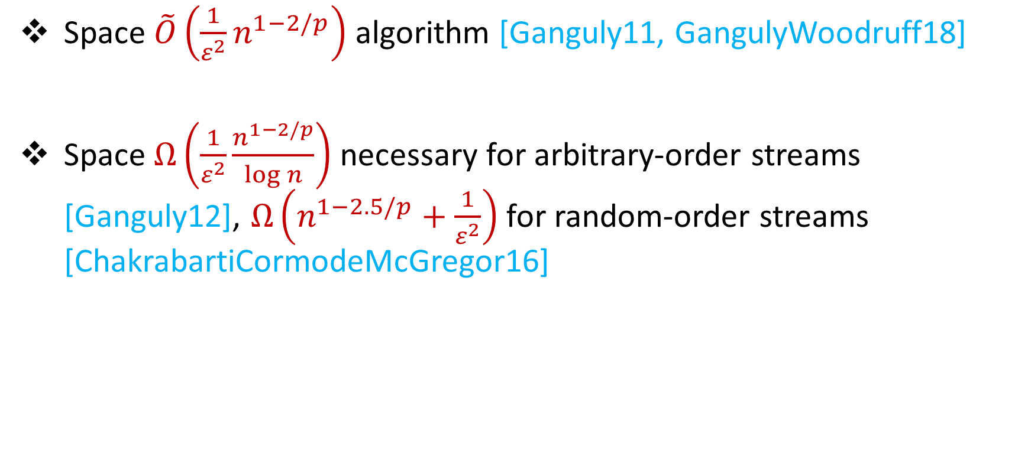
$\left(1+ε\right)$-Approximation for $F_{p}$ with $p>2$
Space $\tilde{O}\left(\frac{1}{ε^{2}}n^{1−2/p}\right)$ algorithm [Ganguly11, GangulyWoodruff18]
Space $Ω\left(\frac{1}{ε^{2}}\frac{n^{1−2/p}}{\log{n}}\right)$ necessary for arbitrary-order streams [Ganguly12], $Ω\left(n^{1−2.5/p}+\frac{1}{ε^{2}}\right)$ for random-order streams [ChakrabartiCormodeMcGregor16]

Slide 7

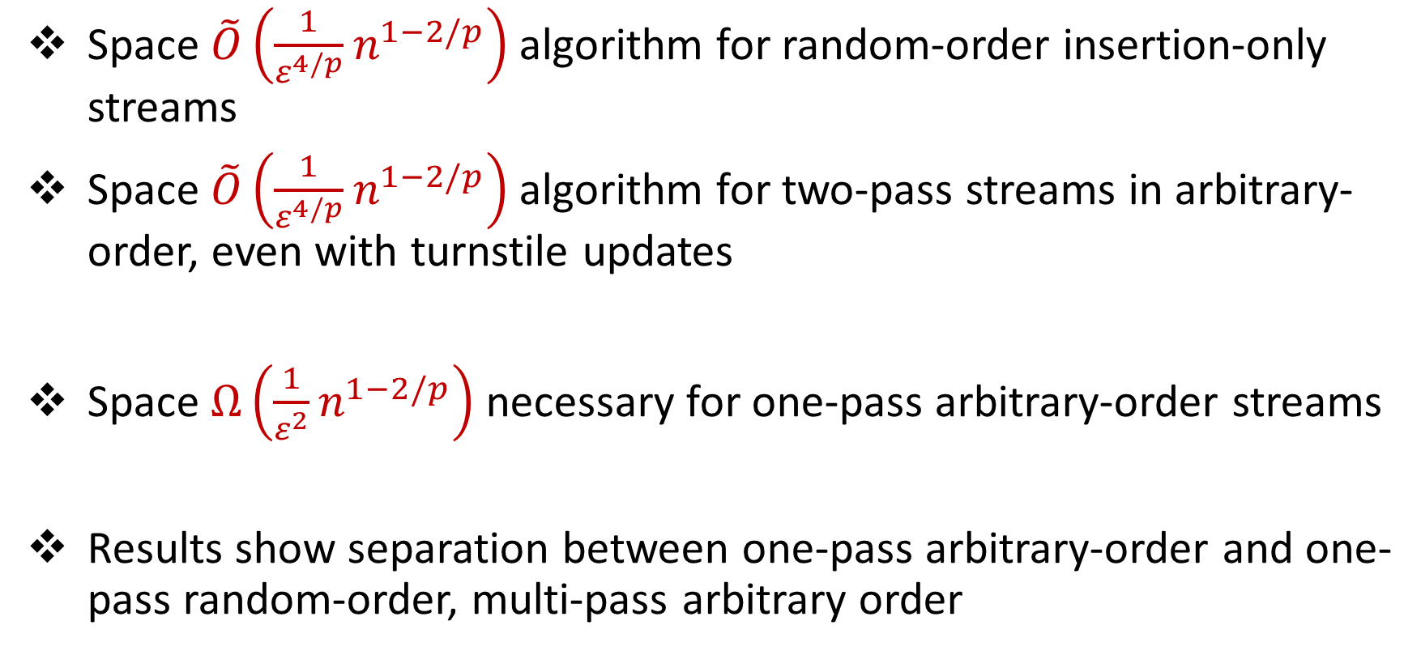
Our Results: $F_{p}$ Moment Estimation, $p>2$
Space $\tilde{O}\left(\frac{1}{ε^{4/p}}n^{1−2/p}\right)$algorithm for random-order insertion-only streams
Space $\tilde{O}\left(\frac{1}{ε^{4/p}}n^{1−2/p}\right)$algorithm for two-pass streams in arbitrary-order, even with turnstile updates
Space $Ω\left(\frac{1}{ε^{2}}n^{1−2/p}\right)$ necessary for one-pass arbitrary-order streams
Results show separation between one-pass arbitrary-order and one-pass random-order, multi-pass arbitrary order

Slide 8

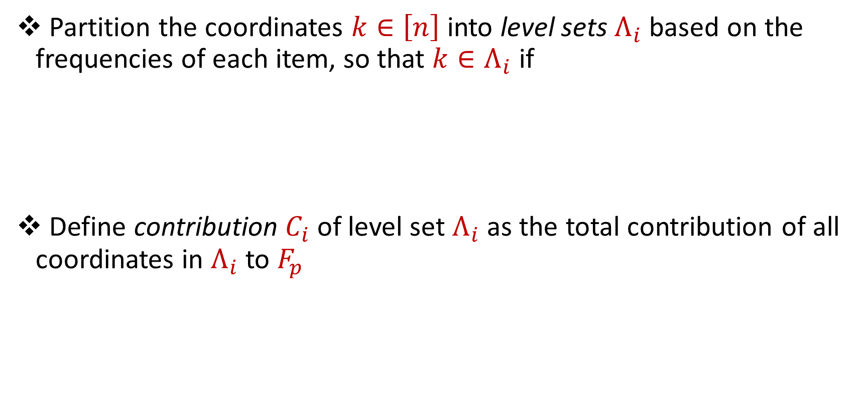

Level Sets
Partition the coordinates $k∈\left[n\right]$ into level sets $Λ_{i}$ based on the frequencies of each item, so that $k∈Λ_{i}$ if
Define contribution $C_{i}$ of level set $Λ_{i}$ as the total contribution of all coordinates in $Λ_{i}$ to $F_{p}$
$$f_{k}^{p}∈\left[\frac{F_{p}}{2^{i}},\frac{2F_{p}}{2^{i}}\right]$$
$$C_{i}= \sum_{k∈Λ_{i}}{f_{k}^{p}}$$

Slide 9
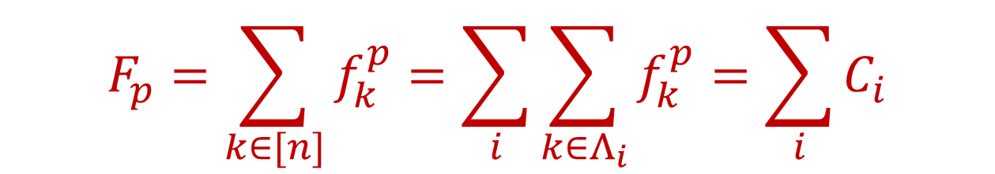
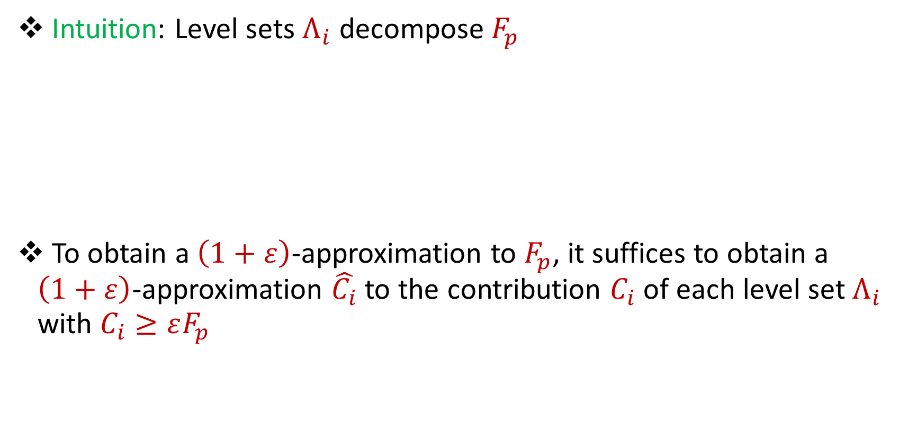
Level Sets
Intuition: Level sets $Λ_{i}$ decompose $F_{p}$
To obtain a $\left(1+ε\right)$-approximation to $F_{p}$, it suffices to obtain a $\left(1+ε\right)$-approximation $\hat{C_{i}}$to the contribution $C_{i}$ of each level set $Λ_{i}$ with $C_{i}≥εF_{p}$
$$F_{p}=\sum_{k∈[n]}{f_{k}^{p}}=\sum_{i}{\sum_{k∈Λ_{i}}{f_{k}^{p}}=\sum_{i}{C_{i}}}$$

Slide 10

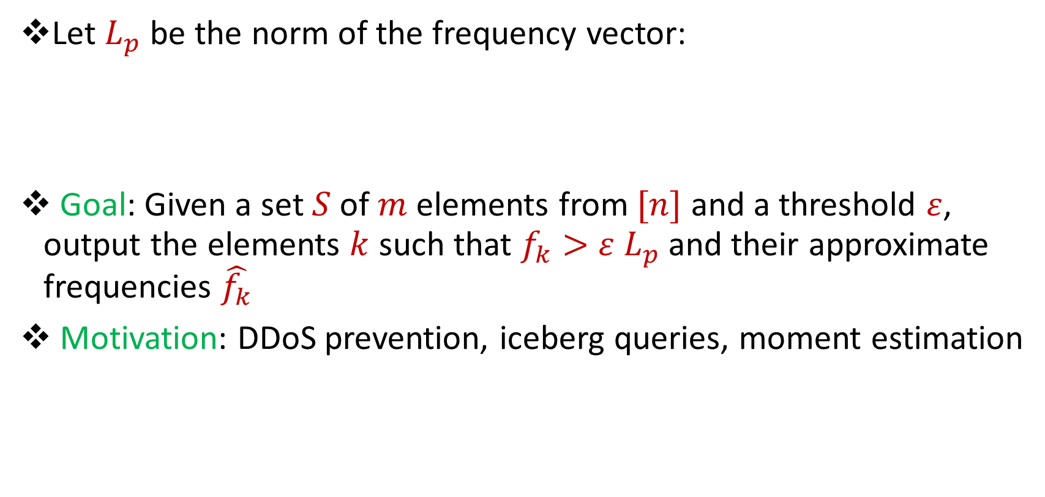
Heavy-Hitters
Let $L_{p}$ be the norm of the frequency vector:
Goal: Given a set $S$ of $m$ elements from $[n]$ and a threshold $ε$, output the elements $k$ such that $f_{k}>$ $ε L_{p}$ and their approximate frequencies $\hat{f_{k}}$
Motivation: DDoS prevention, iceberg queries, moment estimation
$$L_{p}={\left(f_{1}^{p}+f_{2}^{p}+…+f_{n}^{p}\right)}^{1/p}$$

Slide 11
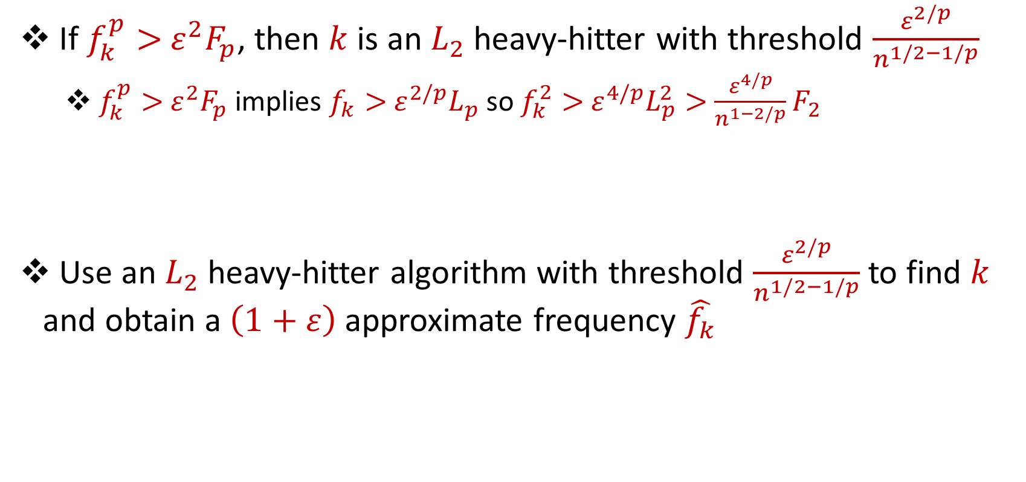
Heavy-Hitters to Level Set Contributions
If $f_{k}^{p}>$ $ε^{2}F_{p}$, then $k$ is an $L_{2}$ heavy-hitter with threshold $\frac{ε^{2/p}}{n^{1/2−1/p}}$
$f_{k}^{p}>$ $ε^{2}F_{p}$ implies $f_{k}>$ $ε^{2/p}L_{p}$ so $f_{k}^{2}>$ $ε^{4/p}L_{p}^{2}>$ $\frac{ε^{4/p}}{n^{1−2/p}}F_{2}$
Use an $L_{2}$ heavy-hitter algorithm with threshold $\frac{ε^{2/p}}{n^{1/2−1/p}}$ to find $k$ and obtain a $\left(1+ε\right)$approximate frequency $\hat{f_{k}}$

Slide 12
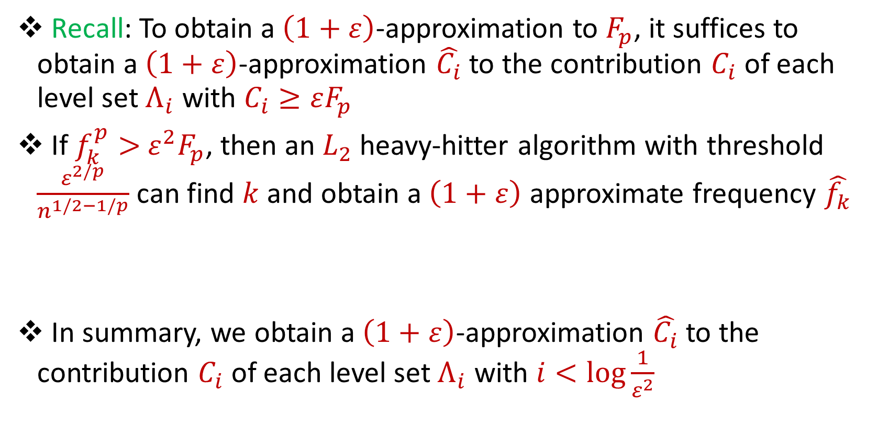
Level Sets with Large Frequencies
Recall: To obtain a $\left(1+ε\right)$-approximation to $F_{p}$, it suffices to obtain a $\left(1+ε\right)$-approximation $\hat{C_{i}}$to the contribution $C_{i}$ of each level set $Λ_{i}$ with $C_{i}≥εF_{p}$
If $f_{k}^{p}>$ $ε^{2}F_{p}$, then an $L_{2}$ heavy-hitter algorithm with threshold $\frac{ε^{2/p}}{n^{1/2−1/p}}$ can find $k$ and obtain a $\left(1+ε\right)$ approximate frequency $\hat{f_{k}}$
In summary, we obtain a $\left(1+ε\right)$-approximation $\hat{C_{i}}$to the contribution $C_{i}$ of each level set $Λ_{i}$ with $i<\log{\frac{1}{ε^{2}}}$

Slide 13
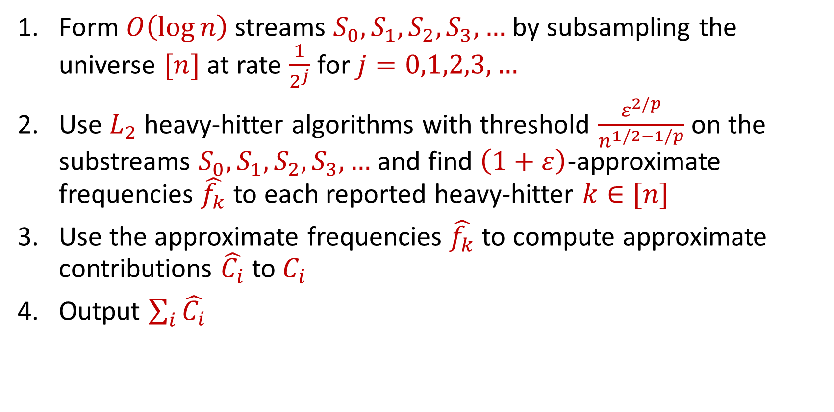
Idealized Algorithm
Form $O\left(\log{n}\right)$ streams $S_{0}, S_{1},S_{2},S_{3},…$ by subsampling the universe $[n]$ at rate $\frac{1}{2^{j}}$ for $j=0,1,2,3,…$
Use $L_{2}$ heavy-hitter algorithms with threshold $\frac{ε^{2/p}}{n^{1/2−1/p}}$ on the substreams $S_{0}, S_{1},S_{2},S_{3},…$ and find $\left(1+ε\right)$-approximate frequencies $\hat{f_{k}}$ to each reported heavy-hitter $k∈[n]$
Use the approximate frequencies $\hat{f_{k}}$ to compute approximate contributions $\hat{C_{i}}$ to $C_{i}$
Output $\sum_{i}{\hat{C_{i}}}$

Slide 14
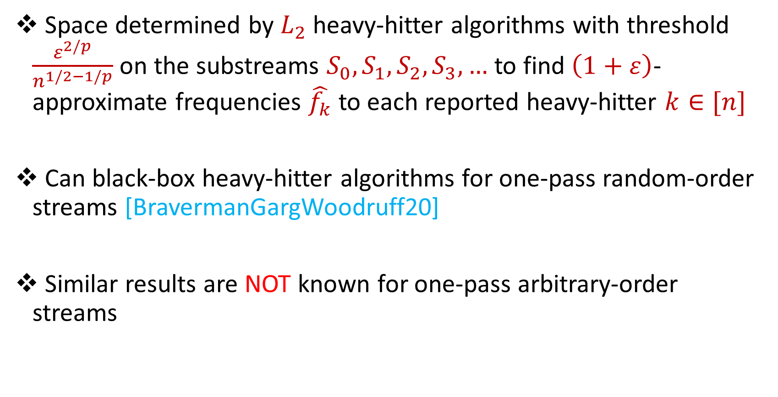
Space Complexity / Source of the Separation
Space determined by $L_{2}$ heavy-hitter algorithms with threshold $\frac{ε^{2/p}}{n^{1/2−1/p}}$ on the substreams $S_{0}, S_{1},S_{2},S_{3},…$ to find $\left(1+ε\right)$-approximate frequencies $\hat{f_{k}}$ to each reported heavy-hitter $k∈[n]$
Can black-box heavy-hitter algorithms for one-pass random-order streams [BravermanGargWoodruff20]
Similar results are NOT known for one-pass arbitrary-order streams

Slide 15

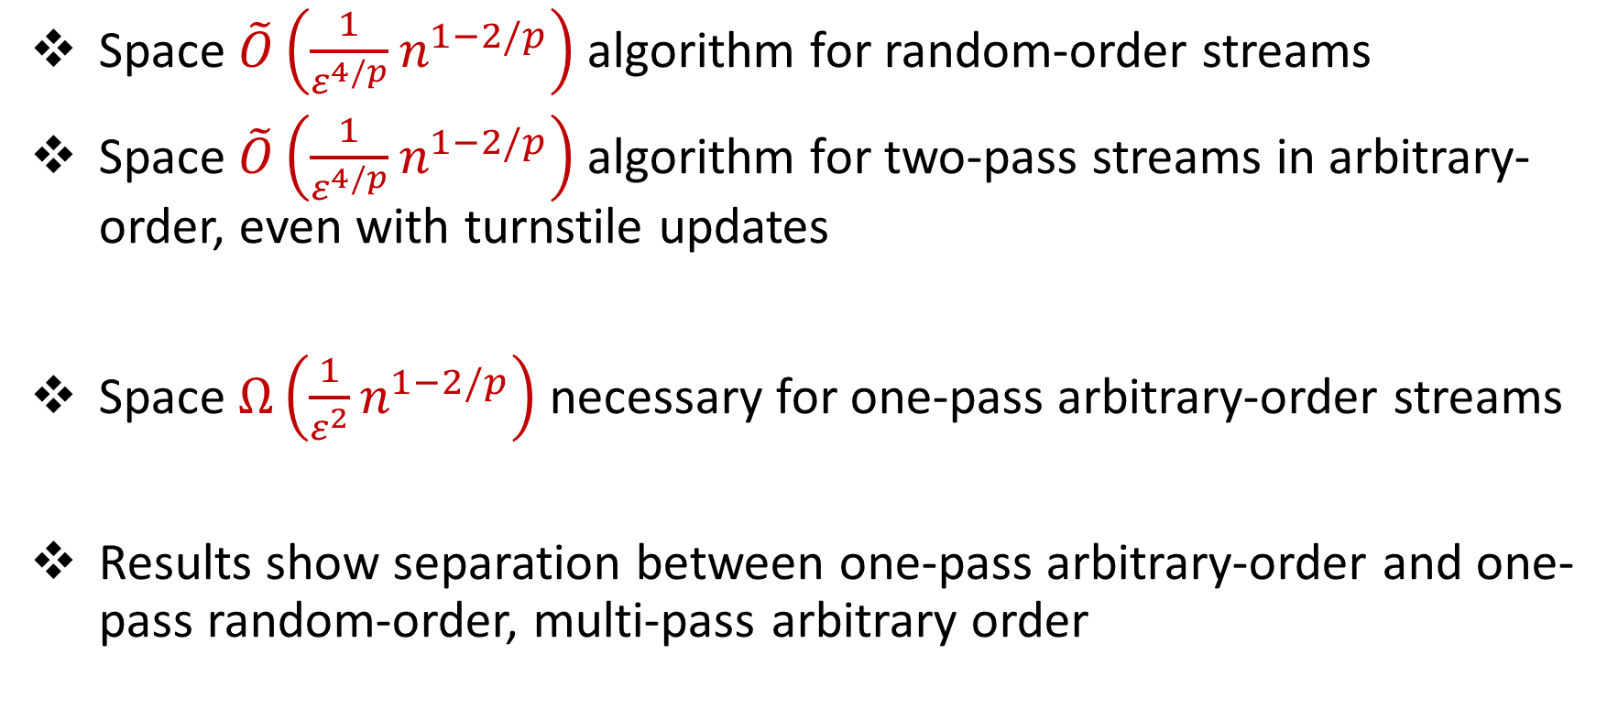
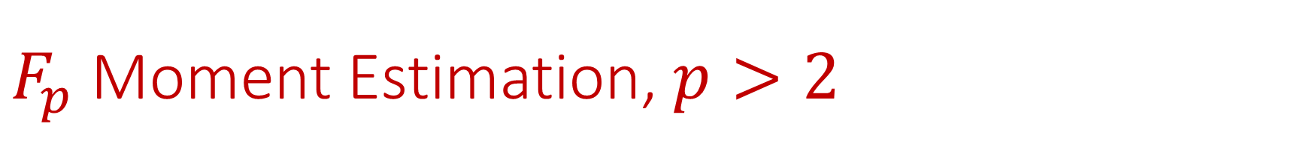
$F_{p}$ Moment Estimation, $p>2$
Space $\tilde{O}\left(\frac{1}{ε^{4/p}}n^{1−2/p}\right)$algorithm for random-order streams
Space $\tilde{O}\left(\frac{1}{ε^{4/p}}n^{1−2/p}\right)$algorithm for two-pass streams in arbitrary-order, even with turnstile updates
Space $Ω\left(\frac{1}{ε^{2}}n^{1−2/p}\right)$ necessary for one-pass arbitrary-order streams
Results show separation between one-pass arbitrary-order and one-pass random-order, multi-pass arbitrary order

Slide 16

Level Sets with Small Frequencies
Remains to approximate the contribution $C_{i}$ of each level set $Λ_{i}$ with $i≥\log{\frac{1}{ε^{2}}}$ and $C_{i}≥εF_{p}$
Suppose $C_{i}=F_{p}$ for some $i≥T$, where $T=log{\frac{1}{ε^{2}}}$
Since $f_{k}^{p}∈\left[\frac{F_{p}}{2^{i}},\frac{2F_{p}}{2^{i}}\right]$ for each $k∈Λ_{i}$, then $\left|Λ_{i}\right|≥2^{i−1}$

Slide 17
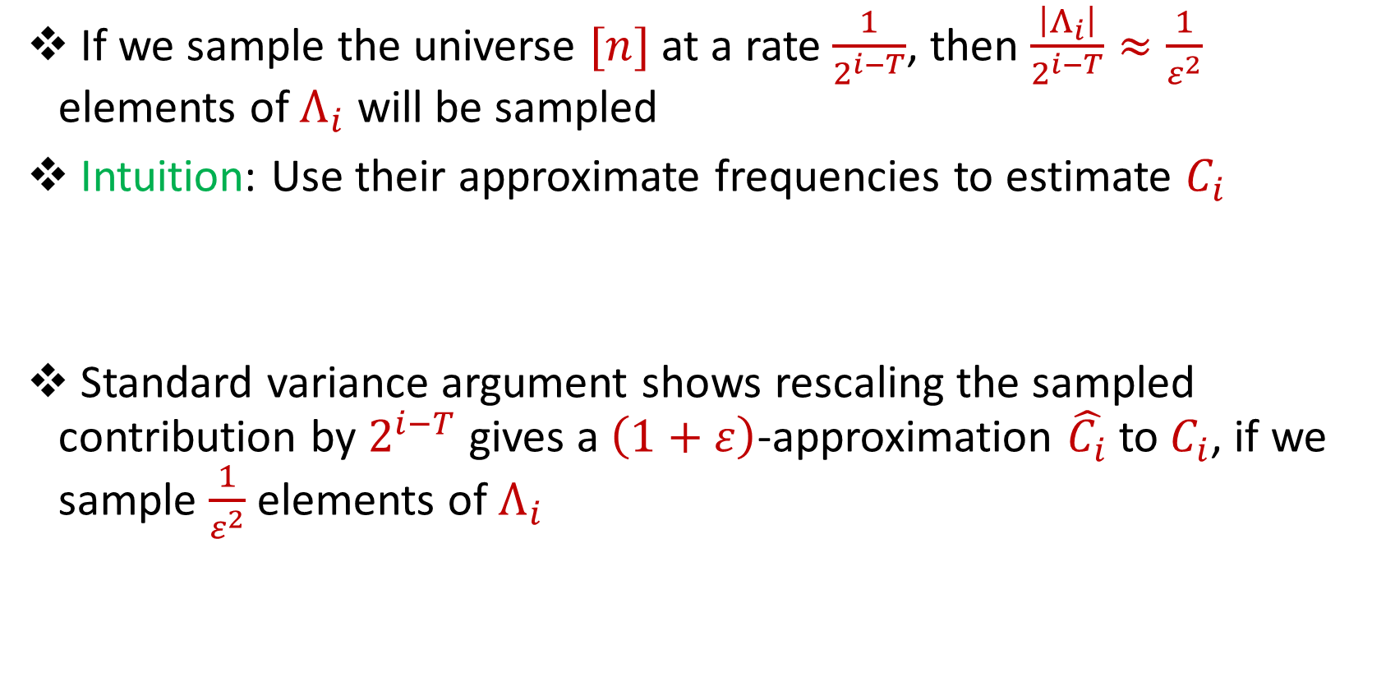
Level Sets with Small Frequencies
If we sample the universe $[n]$ at a rate $\frac{1}{2^{i−T}}$, then $\frac{\left|Λ_{i}\right|}{2^{i−T}}≈\frac{1}{ε^{2}}$ elements of $Λ_{i}$ will be sampled
Intuition: Use their approximate frequencies to estimate $C_{i}$
Standard variance argument shows rescaling the sampled contribution by $2^{i−T}$ gives a $\left(1+ε\right)$-approximation $\hat{C_{i}}$to $C_{i}$, if we sample $\frac{1}{ε^{2}}$ elements of $Λ_{i}$

Slide 18
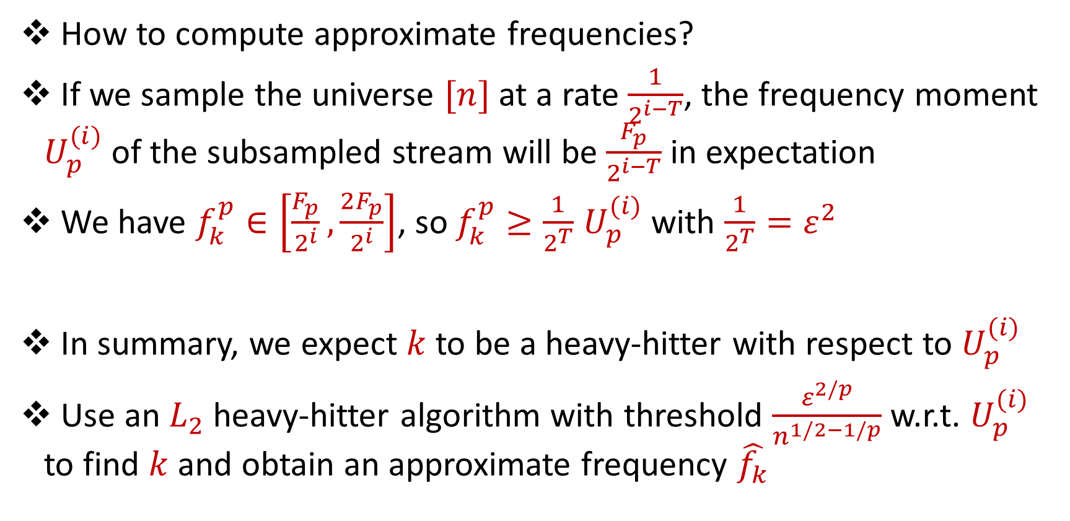
Level Sets with Small Frequencies
How to compute approximate frequencies?
If we sample the universe $[n]$ at a rate $\frac{1}{2^{i−T}}$, the frequency moment $U_{p}^{(i)}$ of the subsampled stream will be $\frac{F_{p}}{2^{i−T}}$ in expectation
We have $f_{k}^{p}∈\left[\frac{F_{p}}{2^{i}},\frac{2F_{p}}{2^{i}}\right]$, so $f_{k}^{p}≥\frac{1}{2^{T}}$ $U_{p}^{(i)}$ with $\frac{1}{2^{T}}=ε^{2}$
In summary, we expect $k$ to be a heavy-hitter with respect to $U_{p}^{(i)}$
Use an $L_{2}$ heavy-hitter algorithm with threshold $\frac{ε^{2/p}}{n^{1/2−1/p}}$ w.r.t. $U_{p}^{(i)}$ to find $k$ and obtain an approximate frequency $\hat{f_{k}}$

Slide 19
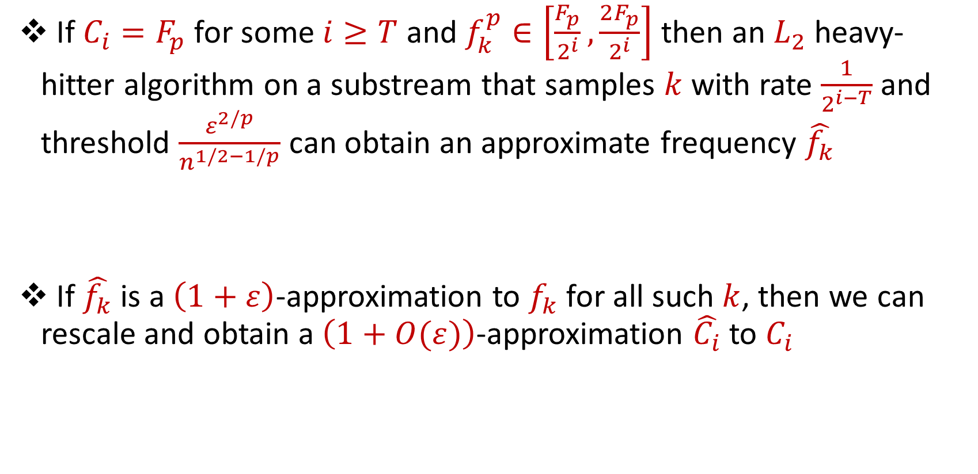
Level Sets with Small Frequencies
If $C_{i}=F_{p}$ for some $i≥T$ and $f_{k}^{p}∈\left[\frac{F_{p}}{2^{i}},\frac{2F_{p}}{2^{i}}\right]$ then an $L_{2}$ heavy-hitter algorithm on a substream that samples $k$with rate $\frac{1}{2^{i−T}}$ and threshold $\frac{ε^{2/p}}{n^{1/2−1/p}}$ can obtain an approximate frequency $\hat{f_{k}}$
If $\hat{f_{k}}$ is a $\left(1+ε\right)$-approximation to $f_{k}$ for all such $k$, then we can rescale and obtain a $\left(1+O(ε)\right)$-approximation $\hat{C_{i}}$to $C_{i}$

Slide 20
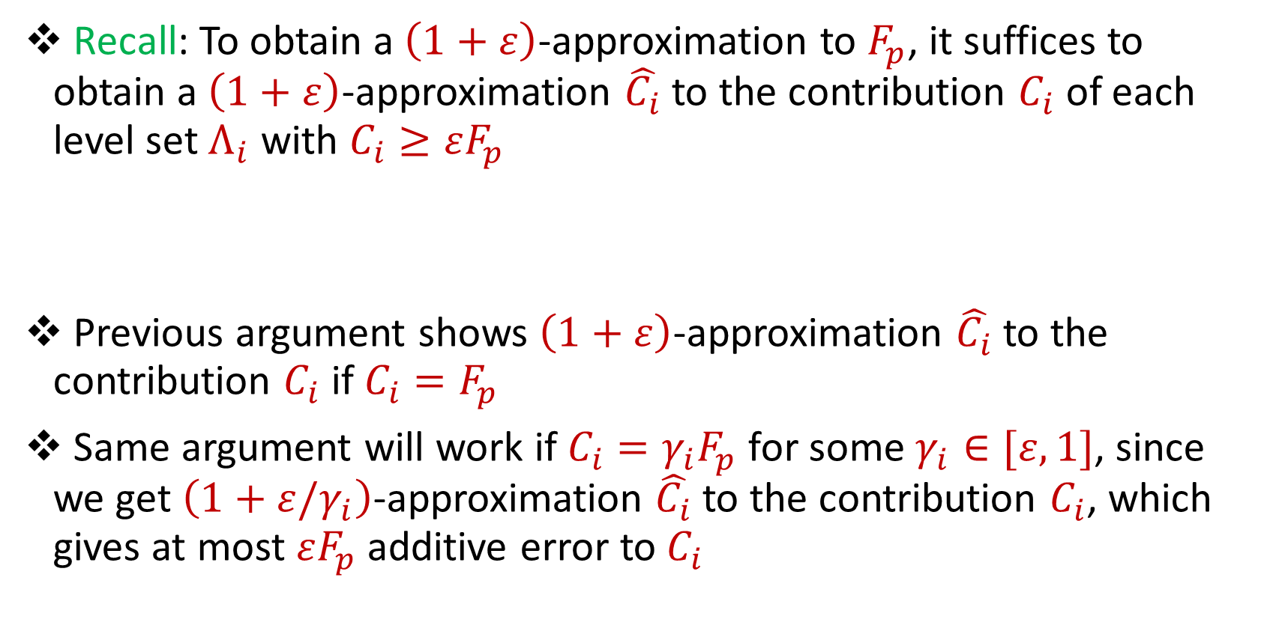
Level Sets with Small Frequencies
Recall: To obtain a $\left(1+ε\right)$-approximation to $F_{p}$, it suffices to obtain a $\left(1+ε\right)$-approximation $\hat{C_{i}}$to the contribution $C_{i}$ of each level set $Λ_{i}$ with $C_{i}≥εF_{p}$
Previous argument shows $\left(1+ε\right)$-approximation $\hat{C_{i}}$to the contribution $C_{i}$ if $C_{i}=F_{p}$
Same argument will work if $C_{i}={γ_{i}F}_{p}$ for some $γ_{i}∈[ε, 1]$, since we get $\left(1+ε/γ_{i}\right)$-approximation $\hat{C_{i}}$to the contribution $C_{i}$, which gives at most $εF_{p}$ additive error to $C_{i}$

Slide 21
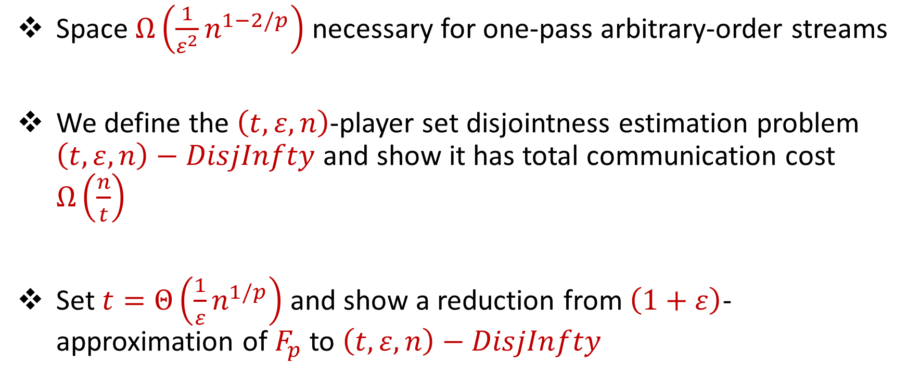
Lower Bound
Space $Ω\left(\frac{1}{ε^{2}}n^{1−2/p}\right)$ necessary for one-pass arbitrary-order streams
We define the $\left(t,ε, n\right)$-player set disjointness estimation problem $\left(t,ε, n\right)−DisjInfty$ and show it has total communication cost $Ω\left(\frac{n}{t}\right)$
Set $t=Θ\left(\frac{1}{ε}n^{1/p}\right)$ and show a reduction from $\left(1+ε\right)$-approximation of $F_{p}$to $\left(t,ε, n\right)−DisjInfty$

Slide 22
Lower Bound
Space $Ω\left(\frac{1}{ε^{2}}n^{1−2/p}\right)$ necessary for one-pass arbitrary-order streams
We define the $\left(t,ε, n\right)$-player set disjointness estimation problem $\left(t,ε, n\right)−DisjInfty$ and show it has total communication cost $Ω\left(\frac{n}{t}\right)$
Set $t=Θ\left(\frac{1}{ε}n^{1/p}\right)$ and show a reduction from $\left(1+ε\right)$-approximation of $F_{p}$to $\left(t,ε, n\right)−DisjInfty$

Slide 23
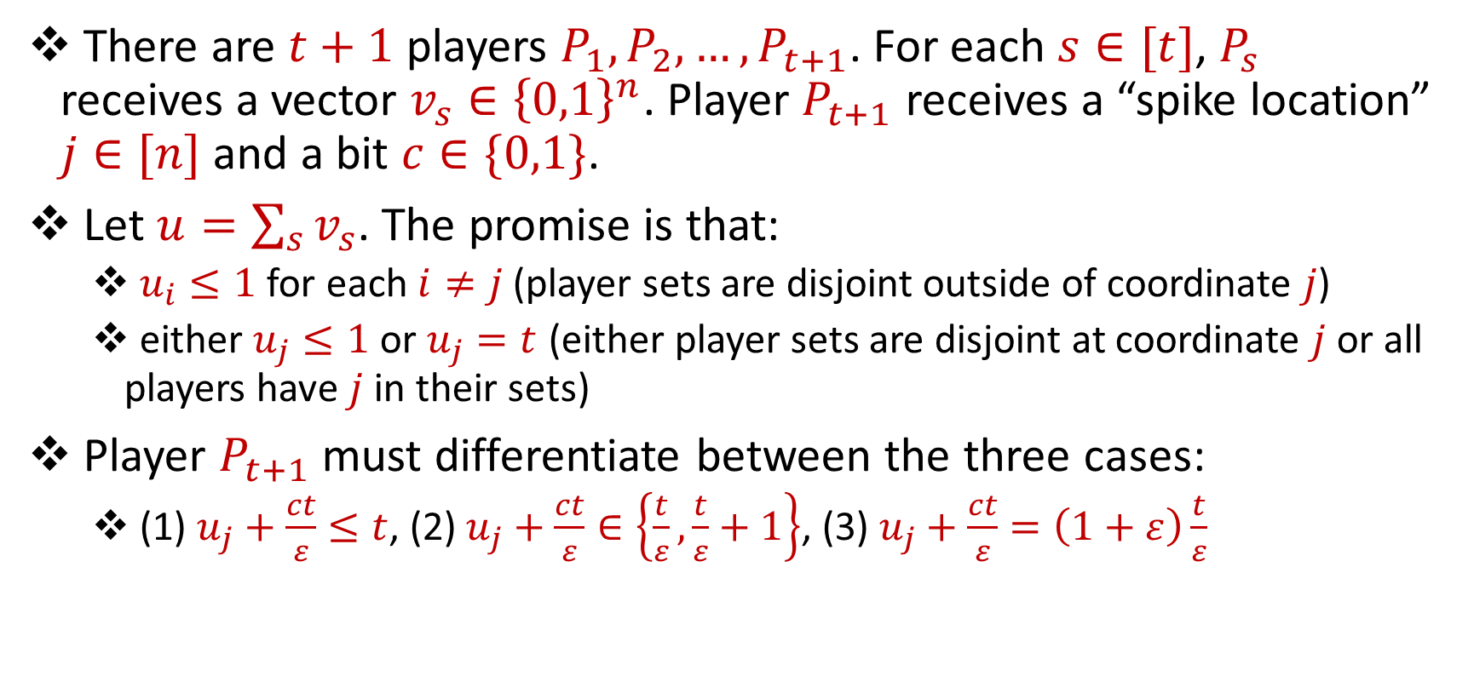
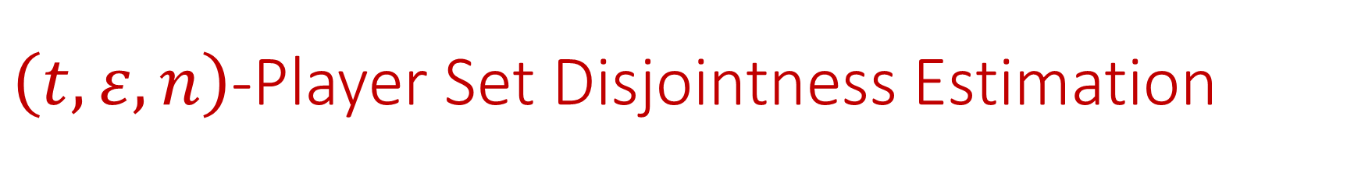
$\left(t,ε, n\right)$-Player Set Disjointness Estimation
There are $t+1$ players $P_{1},P_{2},…,P_{t+1}$. For each $s∈[t]$, $P_{s}$ receives a vector $v_{s}∈{\left\{0,1\right\}}^{n}$. Player $P_{t+1}$ receives a “spike location” $j∈[n]$ and a bit $c∈\{0,1\}$.
Let $u=\sum_{s}{v_{s}}$. The promise is that:
$u_{i}≤1$ for each $i≠j$ (player sets are disjoint outside of coordinate $j\text{)}$
either $u_{j}≤1$ or $u_{j}=t$ (either player sets are disjoint at coordinate $j$ or all players have $j$ in their sets)
Player $P_{t+1}$ must differentiate between the three cases:
(1) $u_{j}+\frac{ct}{ε}≤t$, (2) $u_{j}+\frac{ct}{ε}∈\left\{\frac{t}{ε},\frac{t}{ε}+1\right\}$, (3) $u_{j}+\frac{ct}{ε}=\left(1+ε\right)\frac{t}{ε}$

Slide 24
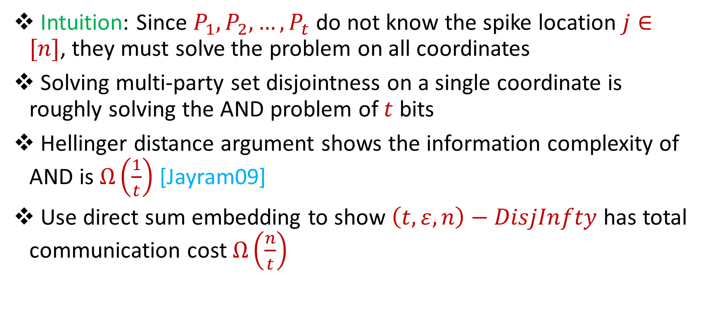
$\left(t,ε, n\right)$-Player Set Disjointness Estimation
Intuition: Since $P_{1},P_{2},…,P_{t}$ do not know the spike location $j∈[n]$, they must solve the problem on all coordinates
Solving multi-party set disjointness on a single coordinate is roughly solving the AND problem of $t$ bits
Hellinger distance argument shows the information complexity of AND is $Ω\left(\frac{1}{t}\right)$ [Jayram09]
Use direct sum embedding to show $\left(t,ε, n\right)−DisjInfty$ has total communication cost $Ω\left(\frac{n}{t}\right)$

Slide 25
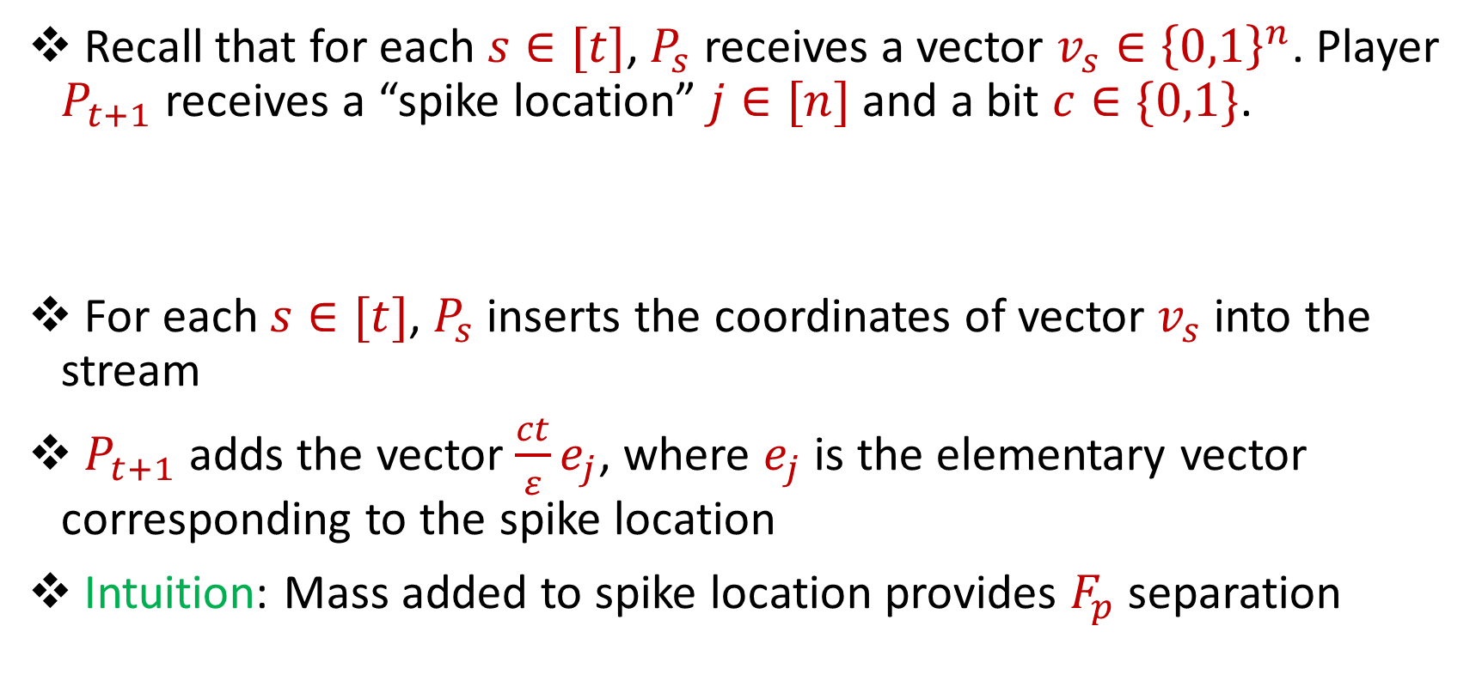
Reduction
Recall that for each $s∈[t]$, $P_{s}$ receives a vector $v_{s}∈{\left\{0,1\right\}}^{n}$. Player $P_{t+1}$ receives a “spike location” $j∈[n]$ and a bit $c∈\{0,1\}$.
For each $s∈[t]$, $P_{s}$ inserts the coordinates of vector $v_{s}$ into the stream
$P_{t+1}$ adds the vector $\frac{ct}{ε}e_{j}$, where $e_{j}$ is the elementary vector corresponding to the spike location
Intuition: Mass added to spike location provides $F_{p}$ separation

Slide 26
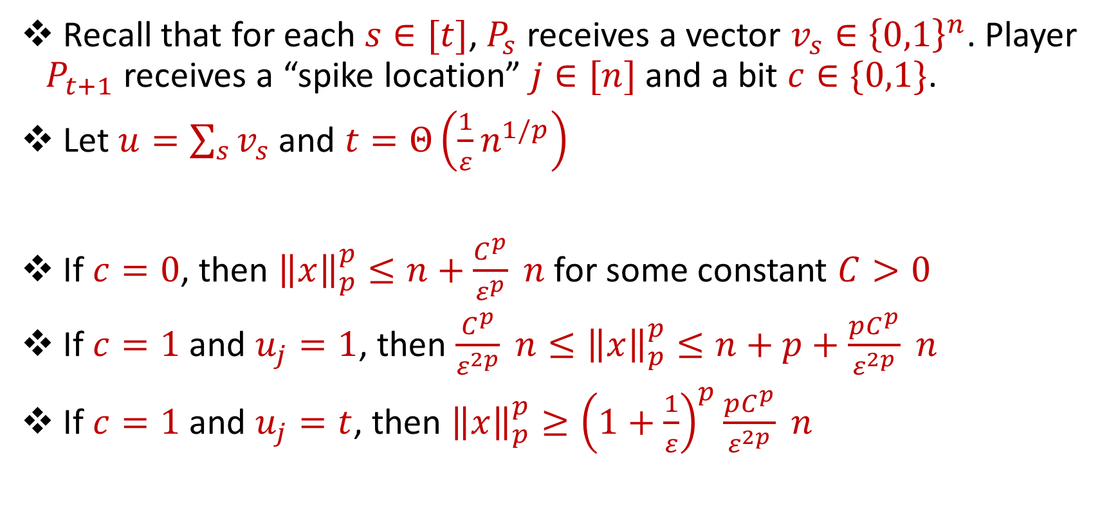
Reduction
Recall that for each $s∈[t]$, $P_{s}$ receives a vector $v_{s}∈{\left\{0,1\right\}}^{n}$. Player $P_{t+1}$ receives a “spike location” $j∈[n]$ and a bit $c∈\{0,1\}$.
Let $u=\sum_{s}{v_{s}}$ and $t=Θ\left(\frac{1}{ε}n^{1/p}\right)$
If $c=0$, then ${\left\|x\right\|}_{p}^{p}≤n+\frac{C^{p}}{ε^{p}} n$ for some constant $C>0$
If $c=1$ and $u_{j}=1$, then $\frac{C^{p}}{ε^{2p}} n≤{\left\|x\right\|}_{p}^{p}≤n+p+\frac{pC^{p}}{ε^{2p}} n$
If $c=1$ and $u_{j}=t$, then ${\left\|x\right\|}_{p}^{p}≥{\left(1+\frac{1}{ε}\right)}^{p}\frac{pC^{p}}{ε^{2p}} n$

Slide 27

Lower Bound
$\left(1+ε\right)$-approximation of $F_{p}$separates these three cases and thus solves $\left(t,ε, n\right)−DisjInfty$ for $t=Θ\left(\frac{1}{ε}n^{1/p}\right)$
$\left(1+ε\right)$-approximation of $F_{p}$requires $Ω\left(\frac{1}{ε^{2}}n^{1−2/p}\right)$ space

